Slide 1



Page 1
BellaBeat
Smart Device
Analysis
Insights to Guide Marketing Strategy
Name: Helen Gbadero
Date: January 13th, 2025

Slide 2


Introduction
Page 2
Objective:
Analyze smart device usage data to understand user behavior patterns and trends, guiding Bellabeat’s marketing strategy and product development.
Data Source:
The analysis is based on Fitbit Fitness Tracker data from 30 users over two months. The dataset includes daily activity, sleep, and calorie metrics.
Tools Used:
SQL Server Management Studio (SSMS) for data cleaning and analysis.
Tableau for data visualization and dashboard creation.

Slide 3

Page 3
Methodology
Product Phases:
Ask: Defined business objectives and key questions.
Prepare: Merged and cleaned Fitbit data, ensuring consistency and accuracy.
Process: Verified data integrity, handled missing values, and removed duplicates.
Analyze: Identified user activity patterns, sleep trends, and calorie expenditure.
Key Considerations:
The dataset does not represent Bellabeat-specific users, limiting demographic-specific insights.
All findings are based on Fitbit data trends, which are applied to Bellabeat’s goals.

Slide 4

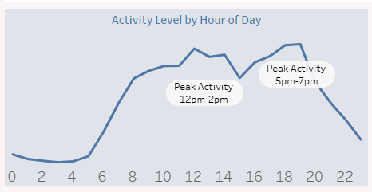

Key Findings
Page 4
User Activity Patterns
Peak Activity Hours:
Users are most active during 12 PM–2 PM and 5 PM–7 PM, suggesting these are prime times for targeted notifications or marketing campaigns .
Weekday vs. Weekend Activity:
Total steps on weekdays are significantly higher than weekends, indicating increased user engagement during weekdays.

Slide 5
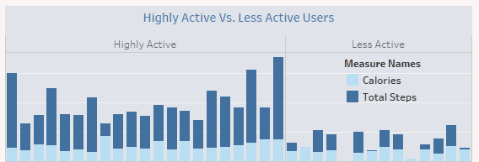
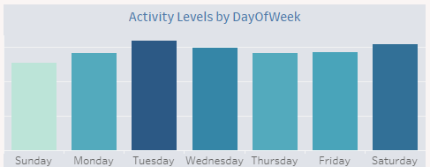
Key Findings
Page 5
User Activity Patterns
Highly Active Vs. Less Active Users:
Highly Active Users contribute significantly more to daily activity, averaging 10,564 steps per day, which is more than 2.3x the steps of less active users and burn an average of 2,541 calories per day, 23.7% more than less active users.
Activity by Day of Week:
Tuesday and Saturday has the highest activity levels, making it ideal for campaigns targeting active users.

Slide 6
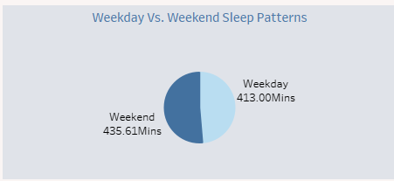
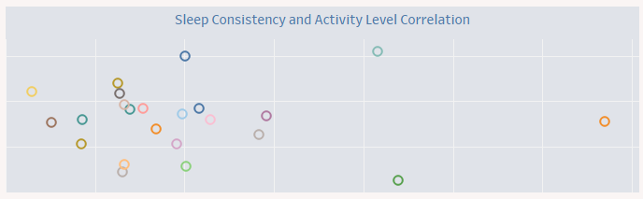
Key Findings
Page 6
Sleep Trends
Weekday vs. Weekend:
On average, users sleep 22.61 minutes longer on weekends (435.61 minutes) compared to weekdays (413 minutes). This trend suggests that users may use weekends to recover from shorter sleep durations during the week.
Sleep Consistency:
Users with consistent sleep schedules contribute 19.56% of total steps, averaging 8,345 steps per user. In contrast, users with inconsistent sleep schedules contribute 80.44% of total steps, averaging 6,861 steps per user.

Slide 7


Page 7
RECOMMENDATIONS
Leverage Peak Activity Hours:
Schedule targeted notifications, reminders, and promotions during 12 PM–2 PM and 5 PM–7 PM, when users are most active. These time slots can also be used to prompt users to engage with specific features like guided workouts or hydration tracking.
Optimize Campaign Timing by Day:
Plan marketing campaigns and product updates for Tuesdays and Saturdays, as these days exhibit the highest activity levels. For instance, run special offers or new content releases on these peak days.
Promote Sleep Health and Recovery:
Highlight the importance of consistent sleep schedules through app notifications and educational content.
Introduce features that track weekend sleep recovery and encourage better weekday sleep hygiene.

Slide 8
Page 8
RECOMMENDATIONS
Enhance Features for Highly Active Users:
Implement progress tracking, gamification, and milestone rewards to keep highly active users engaged.
Offer advanced analytics and personalized goals to maintain motivation for this segment.
Engage Less Active Users:
Design personalized, beginner-level fitness challenges to encourage movement.
Add features that suggest light-intensity activities and progress tracking to motivate less active users gradually.
Expand Product Marketing:
Highlight how Bellabeat devices support increased activity and improved calorie burn, especially for less active users looking to adopt a healthier lifestyle.

Slide 9


Page 9
Conclusion
Bellabeat can leverage these insights to optimize its marketing strategies and product offerings, aligning with user behavior trends. By focusing on activity patterns, sleep consistency, and engagement opportunities, Bellabeat can strengthen its presence in the global smart device market.

Slide 10
Page 10
THANK YOU

